Slide 1

Shri Vishnu Engineering College for Women::Bhimavaram (Autonomous) Department of Computer Science and Engineering
EARLY PREDICTION OF LOW BIRTH WEIGHT (LBW)
CASES USING MACHINE LEARNING APPROACH
IV B.Tech II Sem Project power point presentation
In
Computer Science and Engineering
By
KARRI HEMA HARSHITHA(19B01A0567)
KOMALI ARTHI(19B01A0574)
MUDUNURI TULASI LAKSHMI(19B01A05B4)
NANDIKAM LAKSHMI SAI AKHILA(19B01A05C6)
NARIBOINA VANAJA(20B05A0511)
Under the guidance of
Mrs. K.RATNA KUMARI
Assistant Professor
REVIEW NO : 2
Date: 13-02-2023
Department of Computer Science and Engineering Slide No:1

Slide 2
Introduction:
Low Birth weight (LBW) acts as an indicator of sickness in newborn babies.
Various studies show relation between maternal health during pregnancy and the child’s birth weight.
Here we introduce a application where we classify LBW and NOT-LBW cases using supervised Machine learning for LBW detection.
Department of Computer Science and Engineering Slide No:2

Slide 3
Abstract:
Low birth weight (LBW) has been identiﬁed as a major public health problem around the world.
By this application we predict LBW early so that special care and facilities are to be given to them when they born so that their health condition will be improved.
The technique we are using to Low Birth Weight cases prediction is by using the best among the supervised Machine Learning algorithms like Decision Trees ,Random Forest, Support Vector Machine, XGBoost.
Used in Hospitals, used in Humanitarian aid.
Department of Computer Science and Engineering Slide No:3

Slide 4
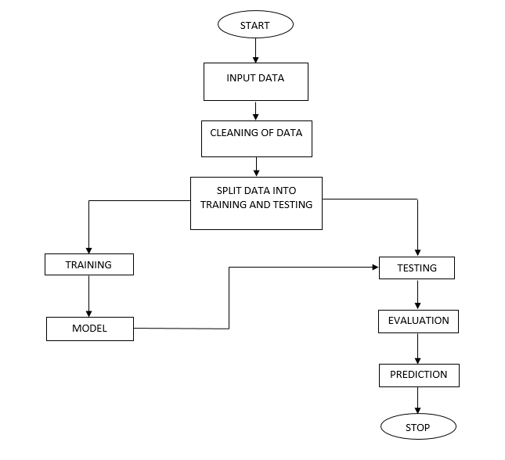
Flowchart:
Department of Computer Science and Engineering Slide No:5

Slide 5
Technical skills for system development:
Operating System : Windows 7+
Server side Script : Python 3.6+
IDE : PyCharm
Libraries Used : Pandas, NumPy, pymysql, random
Framework : Flask
Database : MySQL
Frontend : HTML,CSS
Department of Computer Science and Engineering Slide No:6

Slide 6
Design Comparison:
Existing system Proposed system
Tell manual and that’s risky. High accuracy
Logistic algorithm used which is inaccurate. Time saving
Low accuracy. Does not require highly trained staff
Expensive High reliability
Low reliability Low complexities
Department of Computer Science and Engineering Slide No:17

Slide 7
Implementation:
About Dataset:
Our Dataset contains 93 rows and 10 columns. All the records in the dataset are of type numerical data.
System:
Takes Data
Stores Data
Model Training
Model Prediction
User:
Load Dataset
View Dataset.
Select Model.
Predictions
Department of Computer Science and Engineering Slide No:19

Slide 8
Testing:
The purpose of testing is to discover errors. Testing is the process of trying to discover every conceivable fault or weakness in a work product. It provides a way to check the functionality of components, sub-assemblies, assemblies and/or a finished product.
It is the process of exercising software with the intent of ensuring that the software system meets its requirements and user expectations and does not fail in an unacceptable manner.
There are various types of test. Each test type addresses a specific testing requirement.
Department of Computer Science and Engineering Slide No:20

Slide 9
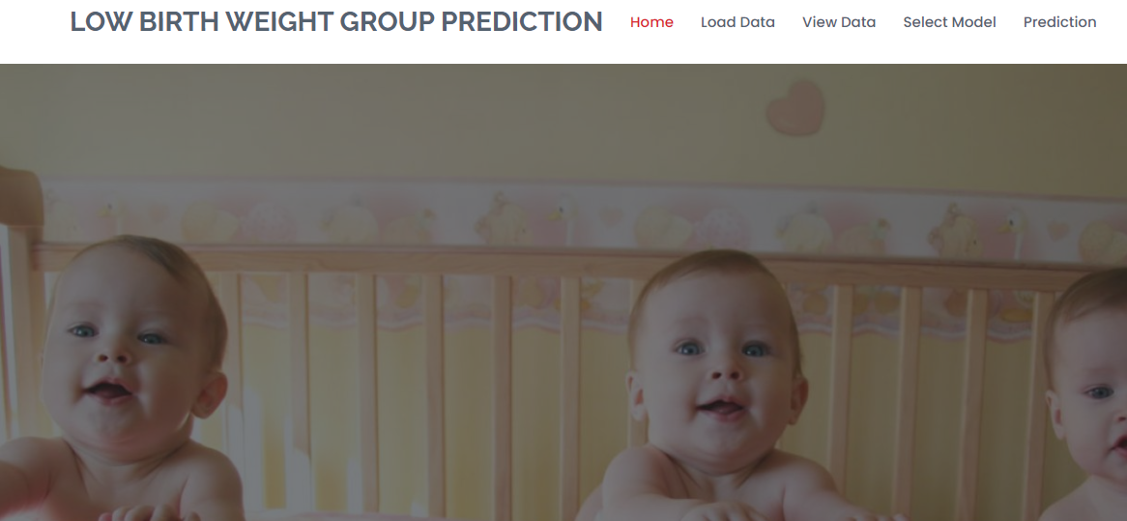
Preliminary results:
HOME PAGE:
Department of Computer Science and Engineering Slide No:21

Slide 10
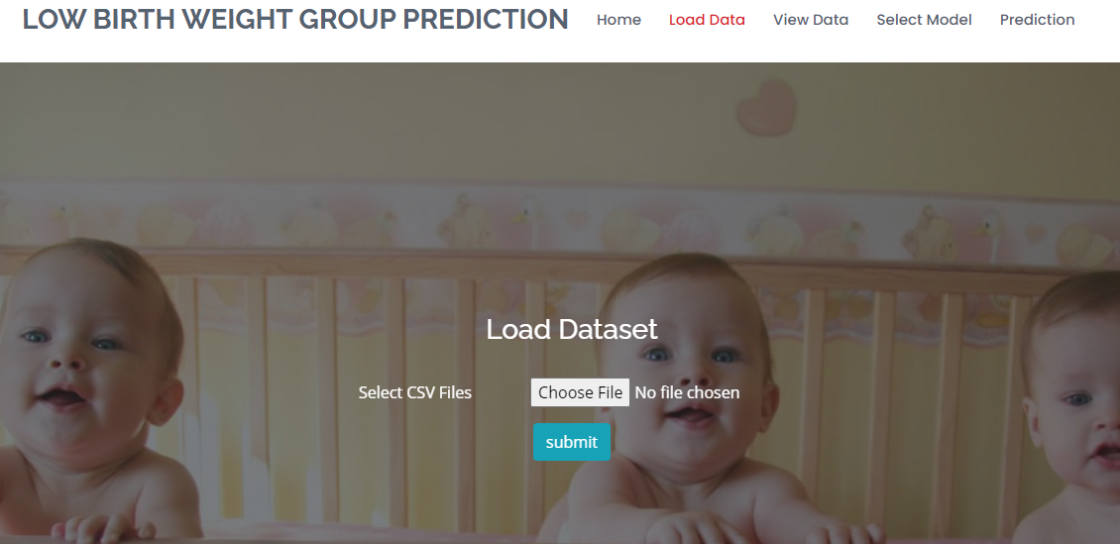
Preliminary results:
DATA LOADING PAGE:
Department of Computer Science and Engineering Slide No:22

Slide 11
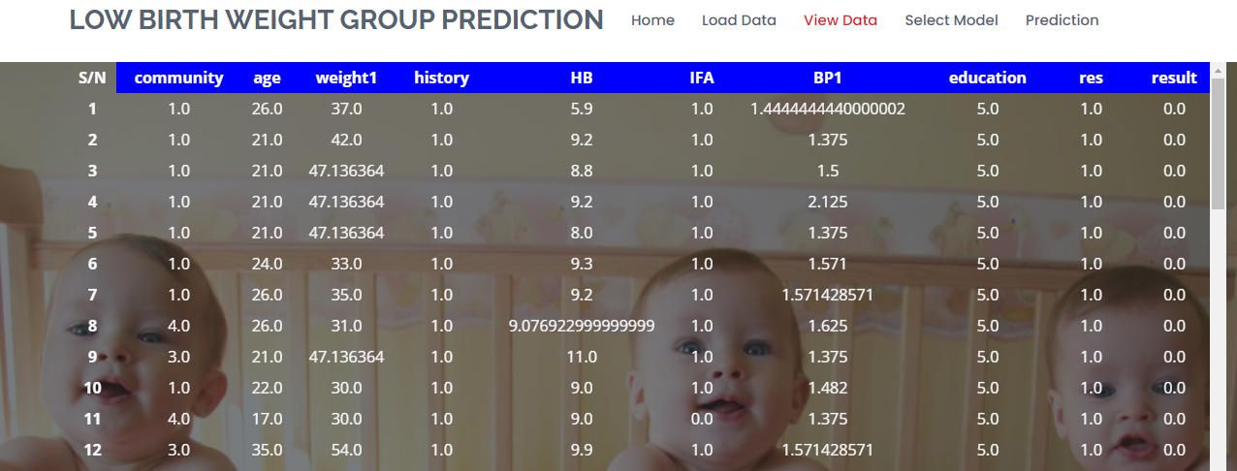
Preliminary results:
DATA VIEWING PAGE:
Department of Computer Science and Engineering Slide No:23

Slide 12
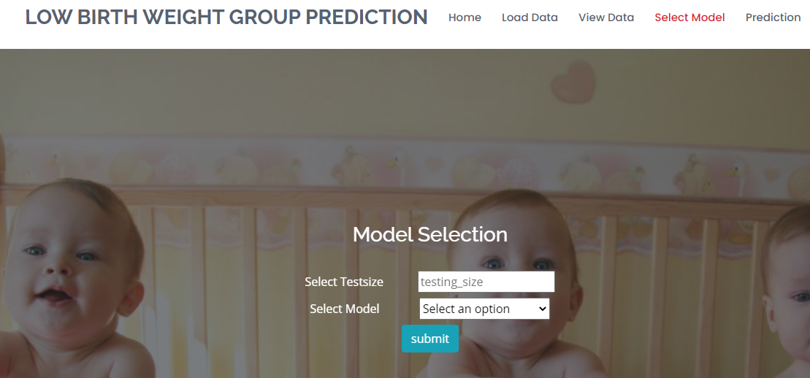
Preliminary results:
MODEL SELECTION PAGE:
Department of Computer Science and Engineering Slide No:24

Slide 13
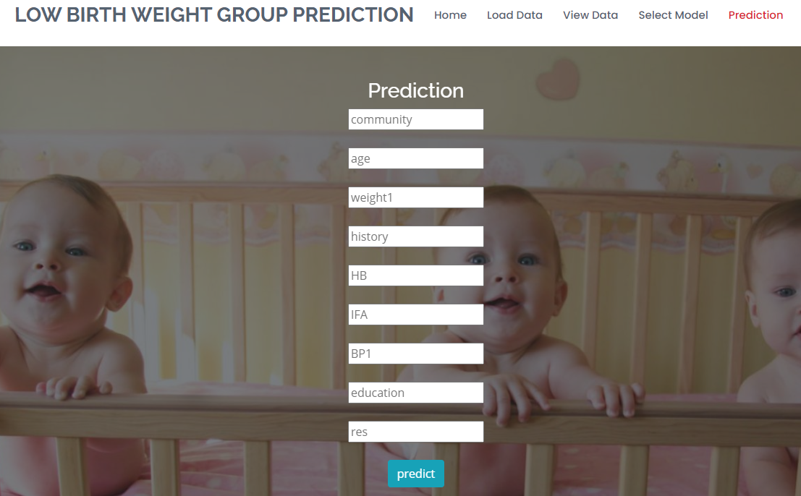
Preliminary results:
PREDICTION PAGE:
Department of Computer Science and Engineering Slide No:25

Slide 14
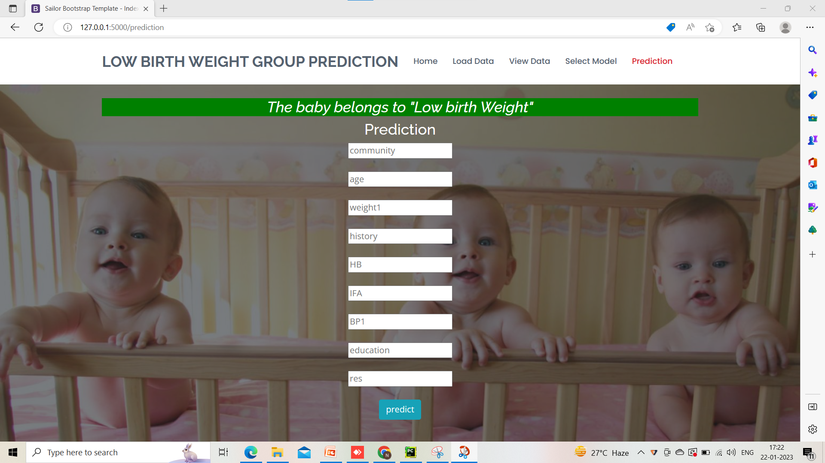
Output:

Slide 15


Slide 16
Thank You
Department of Computer Science and Engineering Slide No:26

